Slide 1
Top 3 Causes of Death in the United States
Project Team 2

Slide 2




The Team
Elizabeth Dutton
Feven Surfael
Jessica Borbon
Stephanie Souza

Slide 3





The Project
Identify Source Data
Clean the Data
Create Code
Statistical Analysis
Data Visualization

Slide 4
In 2005, the top 3 causes of death in the United States were…
Heart Disease
01
Lung Disease
02
Diabetes
03

Slide 5





Heart Disease
The facts…
Is there a relationship between sex and heart disease as a cause of death?
Is there a relationship between age and heart disease as a cause of death?
Is there a relationship between race and heart disease as a cause of death?

Slide 6

The Facts About Heart Disease in the United States in 2005
Initial evaluation of the CDC Mortality source data for 2005 identified the number of individuals that died due to a heart disease related issue in the United States.
Initial evaluation of the US Census source data for 2005 identified the total population of the United States.
The mathematic functions available in Pandas were used to determine the number of individuals dying from heart disease related issues as a percentage of the total population.
Heart Disease related deaths = 346185
The US population ≈ 295.5 million people
This represents 0.12% of the total population of the US that year

Slide 7
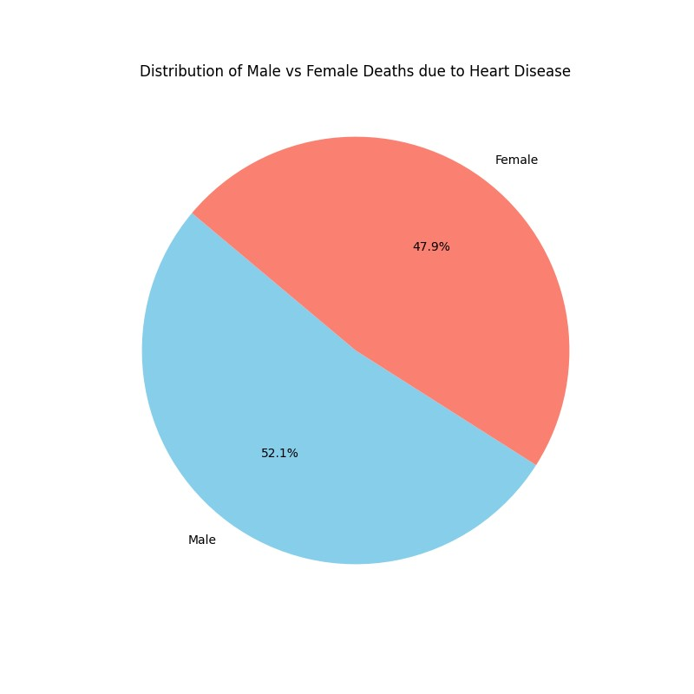
Is there a relationship between sex and heart disease as a cause of death?
Male deaths = 180368 (52.1%)
Female deaths = 165817 (47.9%)
There is a statistically significant difference between male and female deaths in the US due to heart disease. p=4.985e-135 (Chi-Squared test)
In the general population, females make up a slightly higher percentage (50.1%), yet males make up a higher percentage of individuals whose death is attributed to heart disease (52.1%).

Slide 8
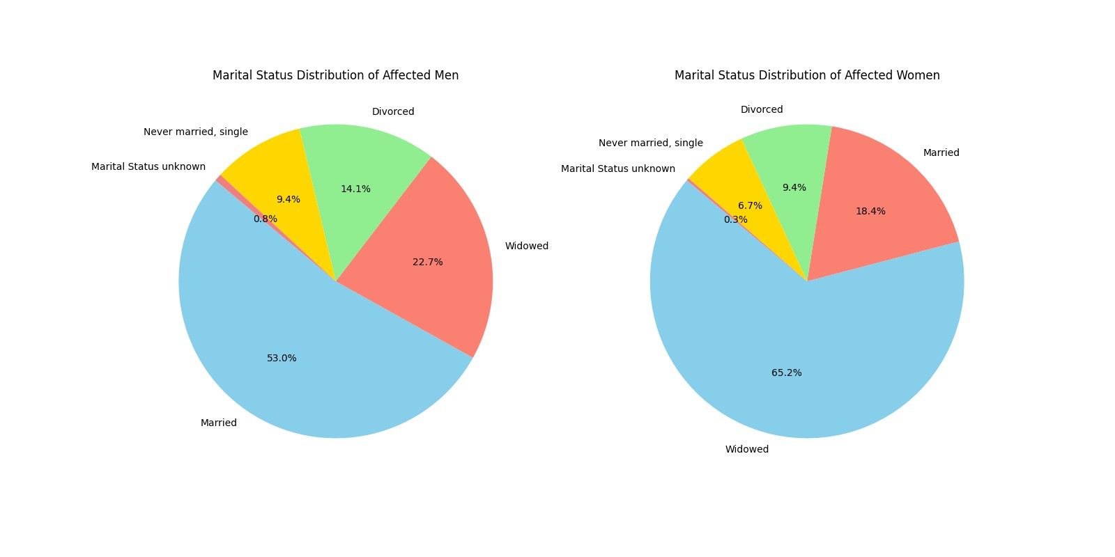
Is there a relationship between sex and heart disease as a cause of death?
A marked difference exists between males and females when the marital status of the individuals dying from heart disease is considered. Over half of men whose cause of death is heart disease are married (53%), while the vast majority of women whose cause of death is heart disease are windowed (65%).

Slide 9
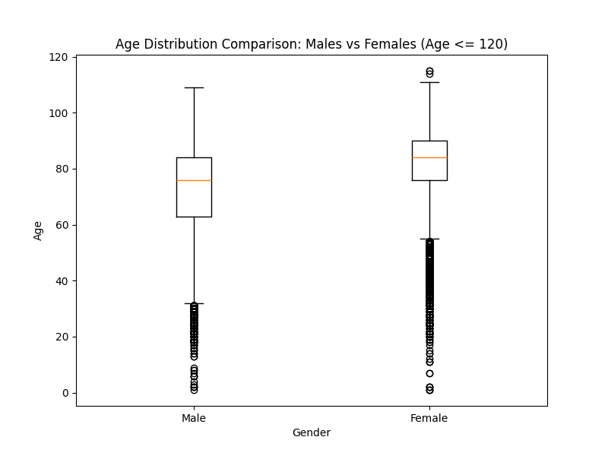
Is there a relationship between sex and heart disease as a cause of death?
When evaluating the mean, median or mode between males and females...in each case, females outlive their males conterparts by 3 to 8 years.

Slide 10
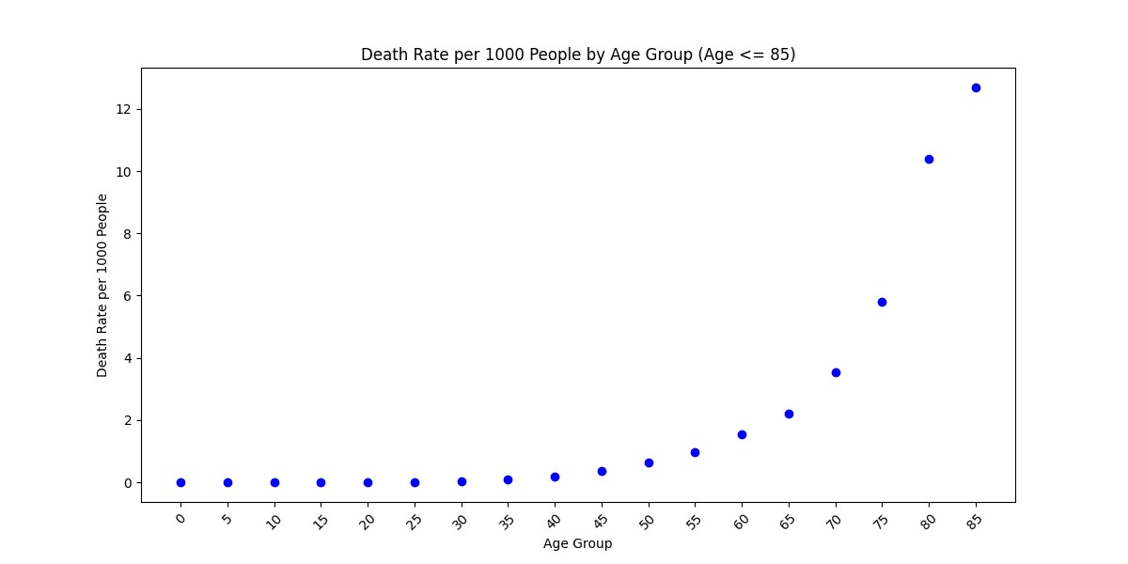
Is there a relationship between age and heart disease as a cause of death?
A statistically significant difference exists in the number of individuals dying from heart disease between age groups (based on 5 year intervals).
ANOVA
p-value: 2.465e-16
Death rate calculated for ages 0-85, in 5 year intervals.

Slide 11
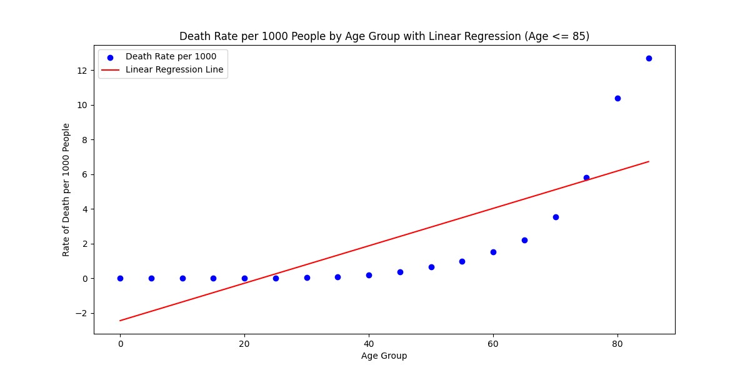
Is there a relationship between age and heart disease as a cause of death?
Linear regression analysis didn’t work for this data
R-squared value: 0.5832

Slide 12
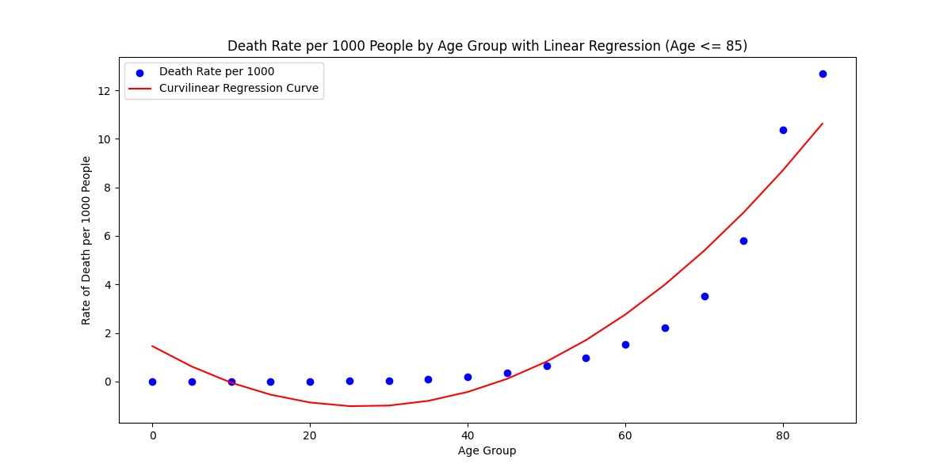
Is there a relationship between age and heart disease as a cause of death?
The "goodness of fit" test was applied to the curved data in the scatter plot. The R-squared value, which describes the goodness of fit between the observed and expected values along the path of the curve, is 0.90. This means the fit of the curve explains 90% of the total variation in the data about the average. This identifies the relationship between the increase in rate of death due to heart disease and advancing age (up to age 85) is statisitcally significant.

Slide 13

Lung Disease
The facts…
Is there a relationship between sex and lung disease as a cause of death?
Is there a relationship between age and lung disease as a cause of death?
Is there a relationship between race and lung disease as a cause of death?

Slide 14
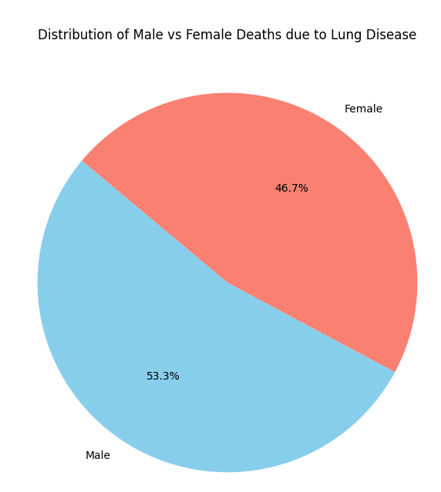
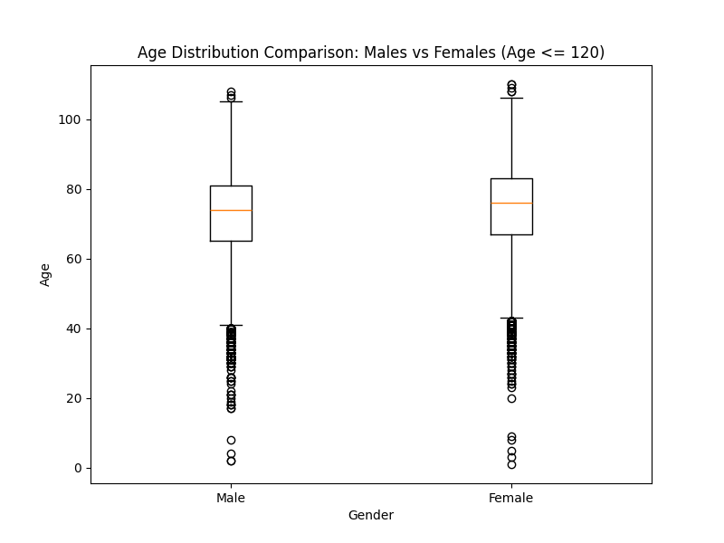
1. Is there a relationship between male and female (gender) dying of lung disease in the US?
Total number of male deaths caused by lung disease: 97520
Total number of of female caused by lung disease: 85465
Based on the provided information, it appears that there is a notable difference in the mortality rates due to lung diseases between men and women, particularly in their seventies.
The data indicates that a considerable number of deaths among both men and women are attributed to lung diseases. However, there is a disparity in the numbers, with a higher mortality rate among men. Specifically, 61,648 men and 58,421 women died due to lung diseases. This suggests that lung diseases contribute significantly to mortality, especially among men.
Number of deaths for males aged 70 and above: 61648
Number of deaths for females aged 70 and above: 58421

Slide 15
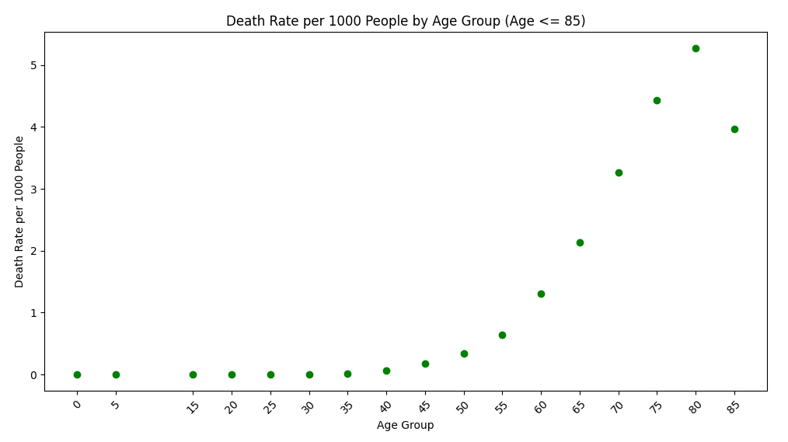
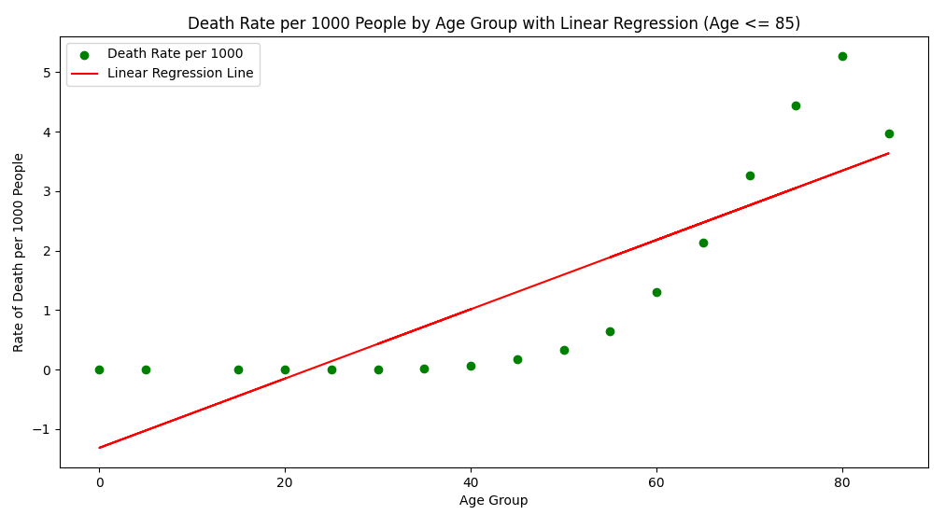
2. Is there a relationship between age and lung disease as a cause of death?
Peak Age Difference:
The peak age is 74 for lung disease-related deaths shows a significant difference between men and women, with the disparity being most noticeable in their seventies.
This implies that individuals in their seventies, especially men, are more susceptible to lung diseases leading to mortality.

Slide 16

Diabetes
The facts…
Is there a relationship between sex and diabetes as a cause of death?
Is there a relationship between age and diabetes as a cause of death?
Is there a relationship between race and diabetes as a cause of death?

Slide 17
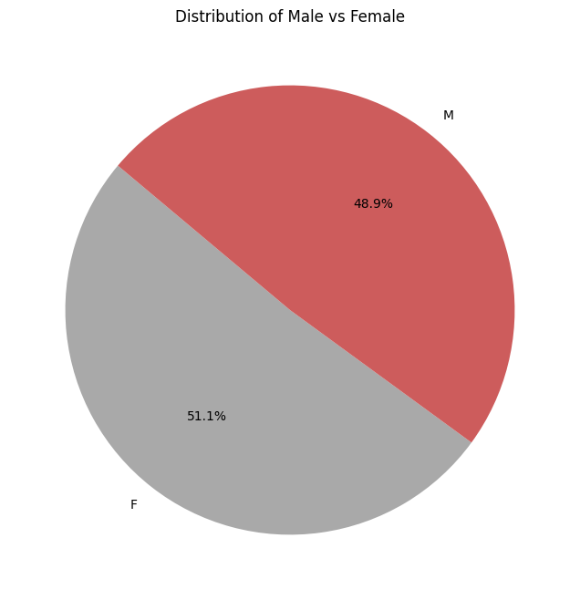
Is there a relationship between sex and diabetes as a cause of death?
Number of male deaths from 2005-2015:
324200
Number of female deaths from 2005-2015:
300893

Slide 18
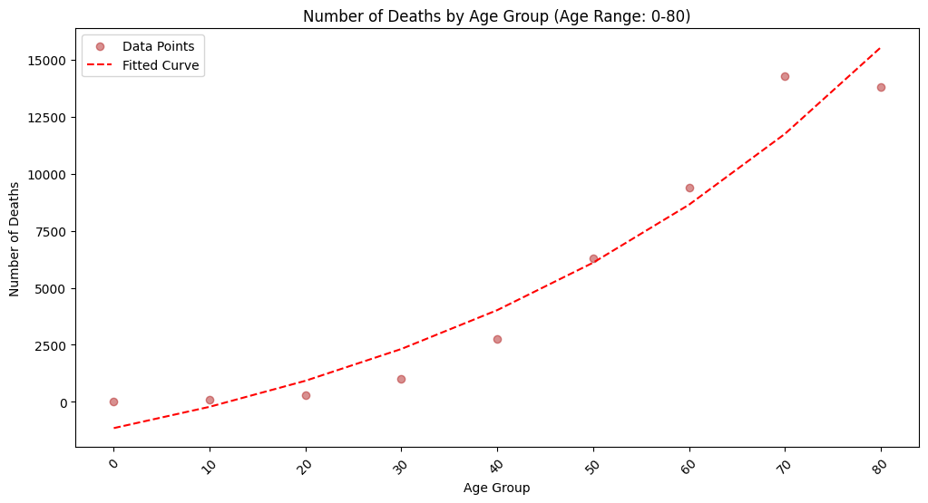
Is there a relationship between age and diabetes as a cause of death?
As age increases, so does the number of people who die from diabetes

Slide 19
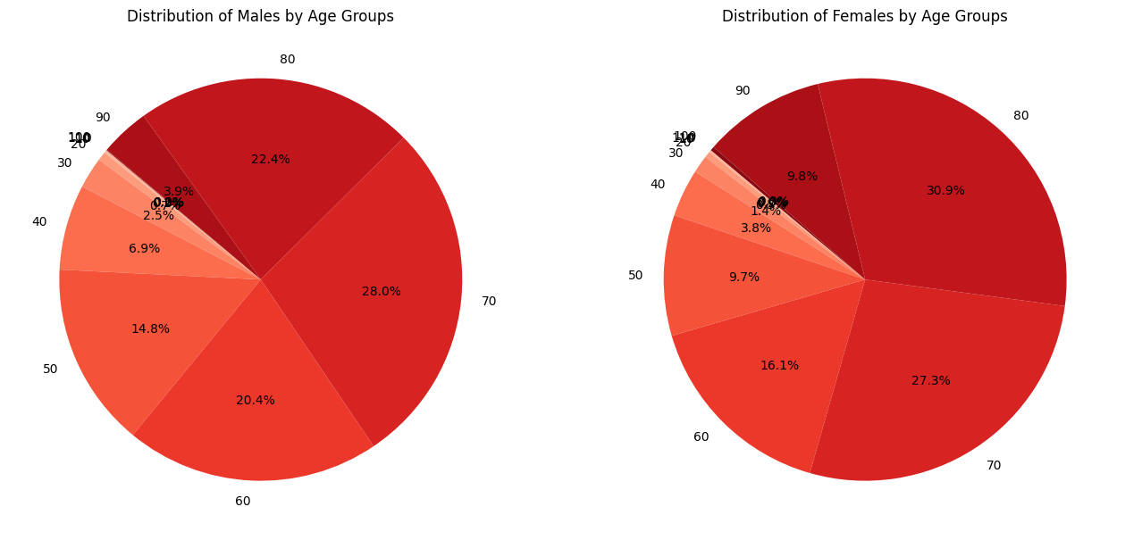

Slide 20


Ten Year Analysis of the Top 3 Causes of Death in the US: 2005-2015
Race Distribution of Top 3 Causes of Death in the US
Trend Across Time for the Top 3 Causes of Death in the US

Slide 21
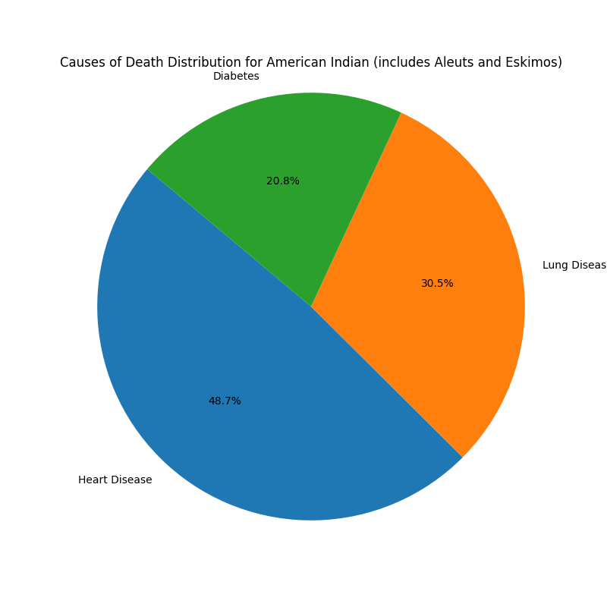
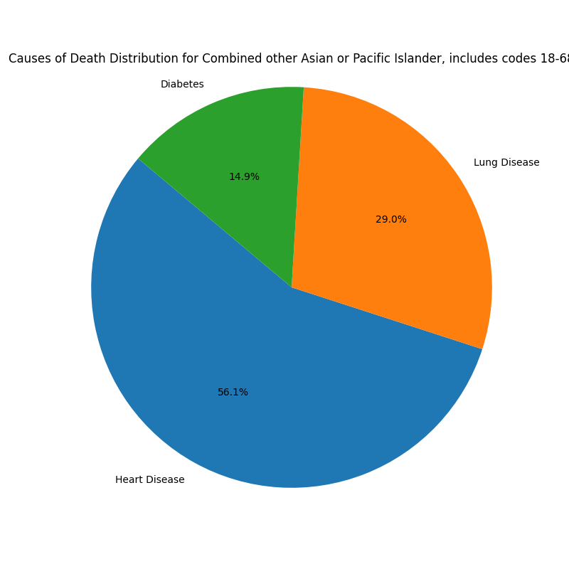
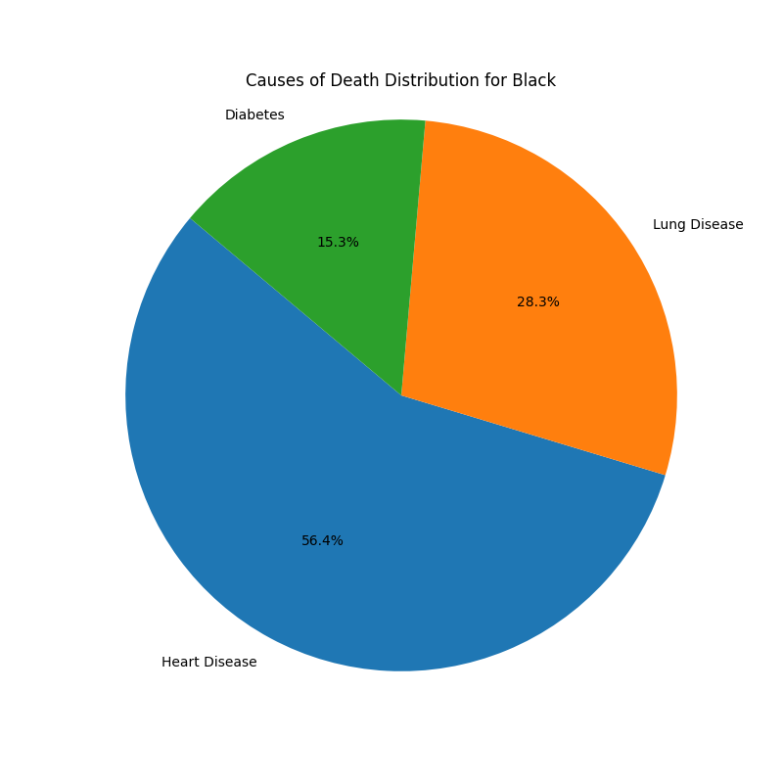
Race Distribution of Top 3 Causes of Death in the US

Slide 22
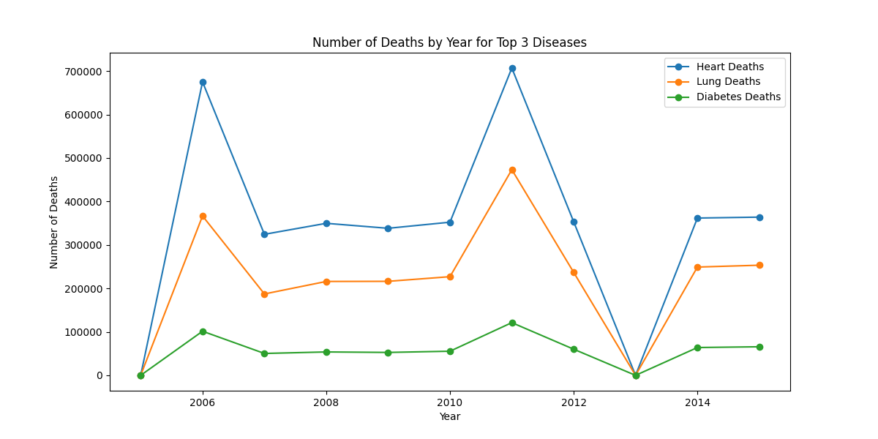
Trend Across Time for the Top 3 Causes of Death in the US

Slide 23
Any Questions?

